Slide 1

Visual Basic.NET Introduction

Slide 2
ROAD MAP
Introduction
Programming Word
Spellchecking Automation of Documents
Programming Excel
Using the Worksheets Collection and Worksheet Object
Range Object
Math Parser Automation
Programming Outlook
Retrieve Emails, Automatic Replying Emails

Slide 3
INTRODUCTION
object model
a collection of classes that represents the objects, or entities, each application can handle, the properties that determine the characteristics of these entities, and the methods that act on them
E.g Word
The object models of the Office applications aren’t part of Visual Studio

Slide 4
Programming Word
Word
a top-notch word processor
tap into the power of Word through the object model it exposes
create documents, format them, and store them as DOC files
print these files, or e-mail them as attachments to a list of addresses
reuse Word’s spell-checking capabilities to correct documents at runtime
Microsoft Word provides numerous objects
The top-level Word object is the Application object
represents the current instance of the application

Slide 5

Programming Word
To use the object model of Microsoft Word in your VB project
add a reference to the Microsoft Word application to the project
To program against Word’s object
create a variable that represents the application
Under the Application object is the Documents collection
contains a Document object for each open document. Using an object variable of the Document type
open an existing document or create a new document

Slide 6
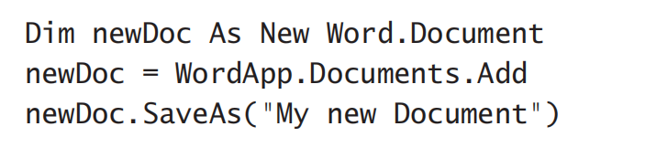
Programming Word
To create a new document
Add method of the Documents collection
If the document has been saved already
The Save Method
Three arguments are optional

Slide 7


Programming Word
If you have multiple open documents at once
select the active document with the ActiveDocument property
After you’re done processing the document
the SaveAs method

Slide 8
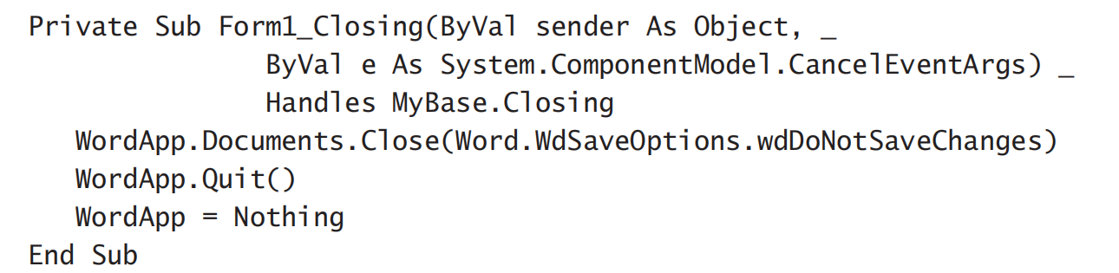
Programming Word
To terminate the application
Quit method

Slide 9
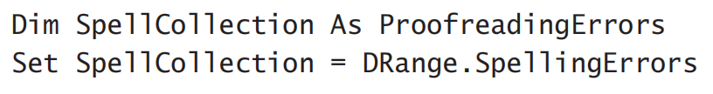
Spell-Checking Documents
ProofreadingErrors collection
a property of the Range object
contains the misspelled words in the Range
Call SpellingErrors method
DRange is Range object (a paragraph or an entire document)
SpellingSuggestions collection
To retrieve the list of alternate words
a method of the Application object, not of the Range object you’re spell-checking

Slide 10

Programming Excel
Add a reference to the Microsoft Excel 9.0 Object Library item
Select Add Reference, and double-click the name of the Excel library
Add an instance of Excel’s object model to your application
Declare a variable of the Excel.Application type
EXL
a new instance of Excel

Slide 11
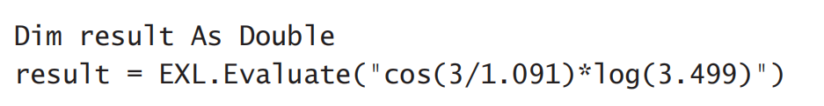
Programming Excel
To access Excel’s functionality
use a hierarchy of objects
Two important methods
the Calculate method: recalculates all open worksheets
the Evaluate method: evaluates math expressions and returns the result

Slide 12
The Worksheets Collection and the Worksheet Object
Each workbook in Excel contains one or more worksheets
Worksheets collection
contains a Worksheet object for each worksheet in the current workbook

Slide 13
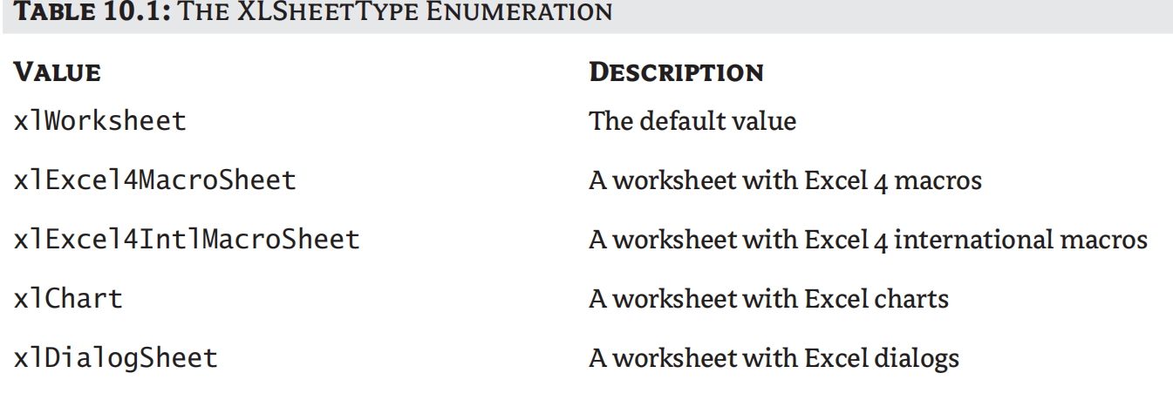
The Worksheets Collection and the Worksheet Object

Slide 14
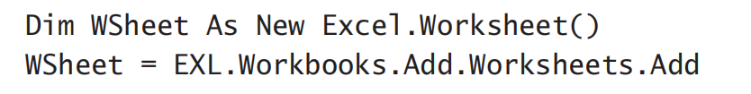
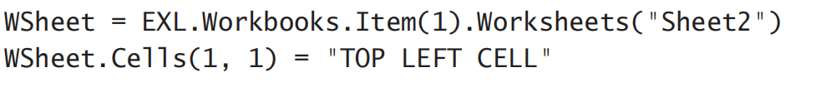
The Worksheets Collection and the Worksheet Object
To create a new worksheet
declare a variable of the Worksheet type
add it to the Worksheets collection
Access the worksheets from within your code and populate them

Slide 15

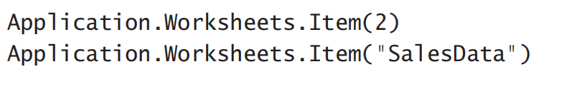
The Worksheets Collection and the Worksheet Object
Add worksheets to the current Workbook with the Add method of the Worksheets collection
To access an individual worksheet
Worksheet collection’s Item method

Slide 16

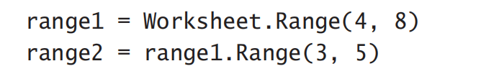
Range Object
The basic object for accessing the contents of a worksheet
Basic Syntax
The Range property is an object

Slide 17

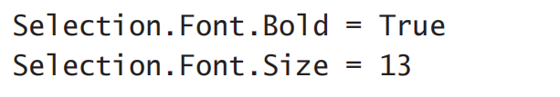
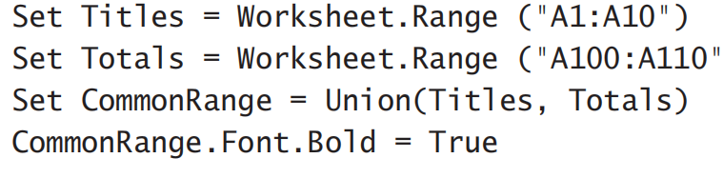
Range Object
To create a Selection object
To change the appearance of the selection
Combine two different ranges with the Union method and assign them to a new Range object

Slide 18
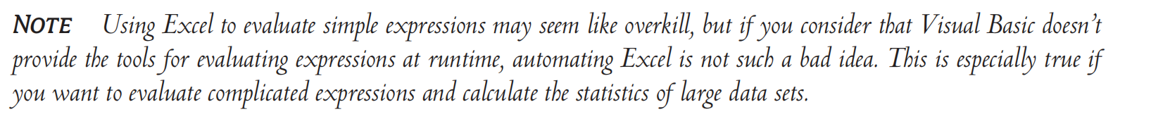
Using Excel as a Math Parser
To evaluate complicated math expressions
Example:
the Evaluate method: Excel.Application object
initialized the ExcelApp object variable

Slide 19
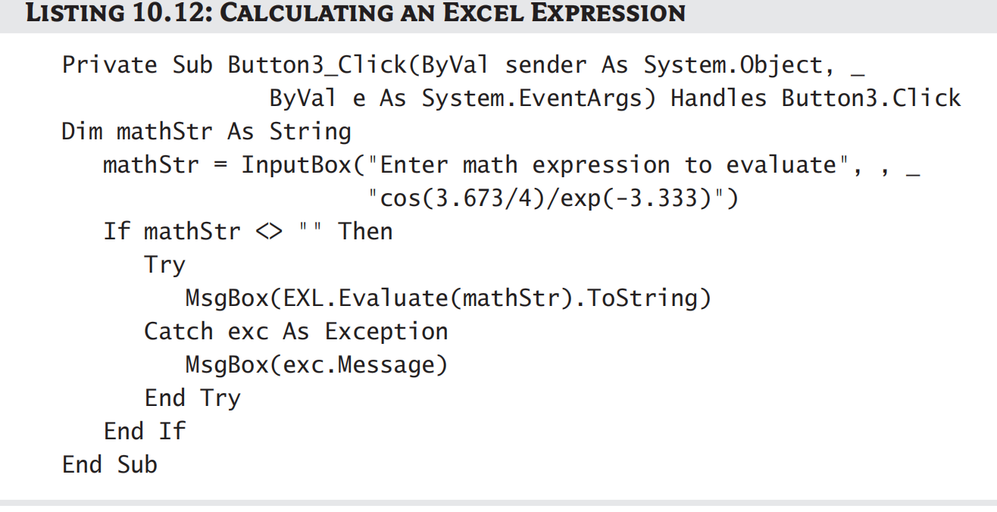
Using Excel as a Math Parser

Slide 20
Programming Outlook
To make your applications e-mail–aware
to mail-enable your Visual Basic applications by manipulating the object model of Outlook
Outlook
maintains a list of contacts organized in folders
Eg. appointment scheduling and routing e-mail

Slide 21
Programming Look
To contact Outlook and program the objects it exposes
Outlook
doesn’t expose a single object like a Document or Worksheet that gives you access to the information it can handle
contains several objects including mail messages, contacts, and tasks

Slide 22
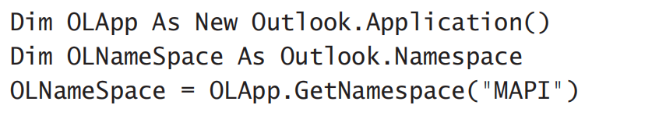
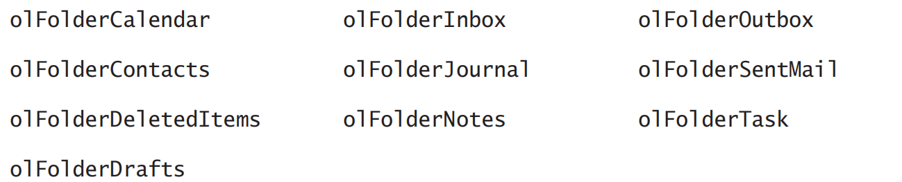
Programming Look
To access the folder objects
create a MAPI message store
The various folders maintained by Outlook can be accessed by:

Slide 23
Programming Outlook
To retrieve all the items in the Contacts folder
Each folder contains different types of information
Contacts folder: ContactItem objects, the Inbox
Outbox folders: MailItem objects
Calendar folder: a collection of AppointmentItem objects.

Slide 24
Retrieving Information
Outlook stores different types of information in different folders
Outlook’s folders do not correspond to physical folders on the disk
just the basic organizational units of Outlook
Contact information
is stored in the Contacts folder
incoming messages
are stored in the Inbox folder

Slide 25
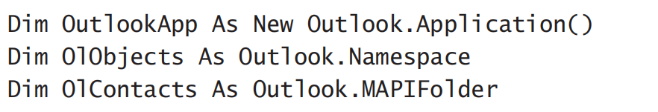
Recursive Scanning of the Contacts Folder
Most users organize their contacts in subfolders to better classify them and simplify searching
recursive programming

Slide 26
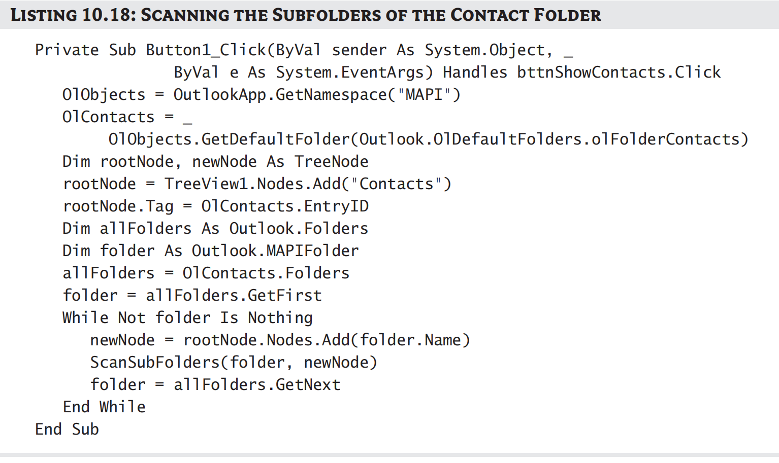
Recursive Scanning of the Contacts Folder

Slide 27
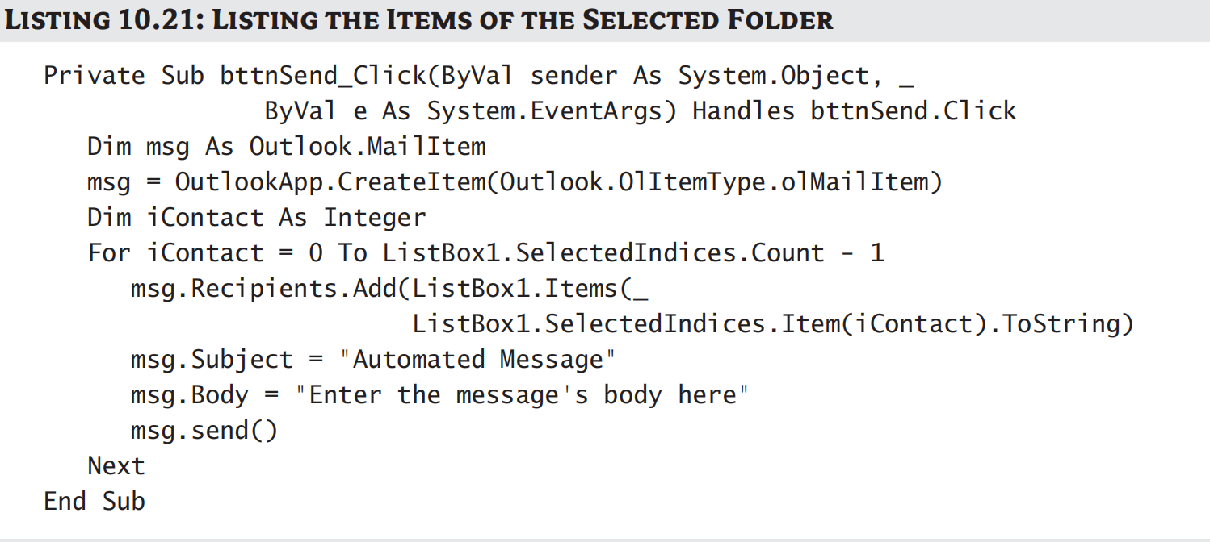
Automated Messages
The message’s subject and body are hard-coded in this project

Slide 28
Exercise
(1) What does “xlWorksheet” mean in XLSheetType enumeration?
(2) If you have multiple open documents at once， what property should you use?
(3) What method should we use to create new document?

